Slide 1

INSPIRE FEATURE PRESENTATION data collection in python.
Justin Whalley

Slide 2

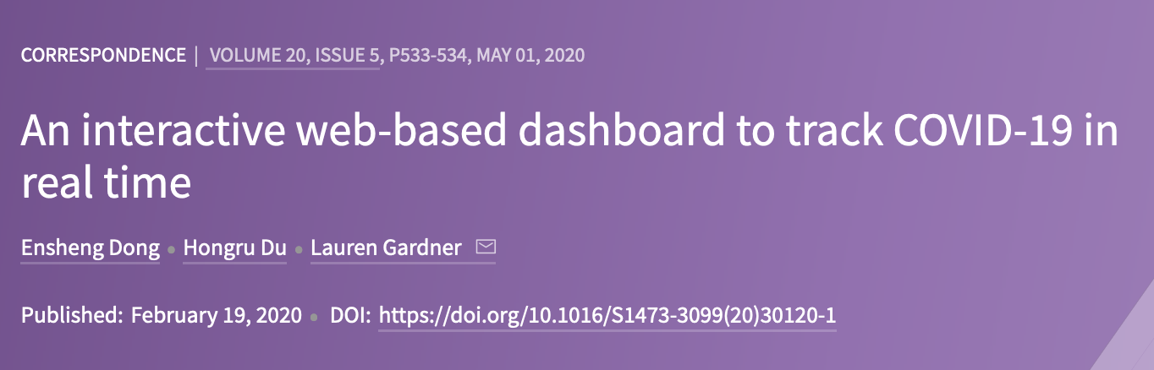

Slide 3
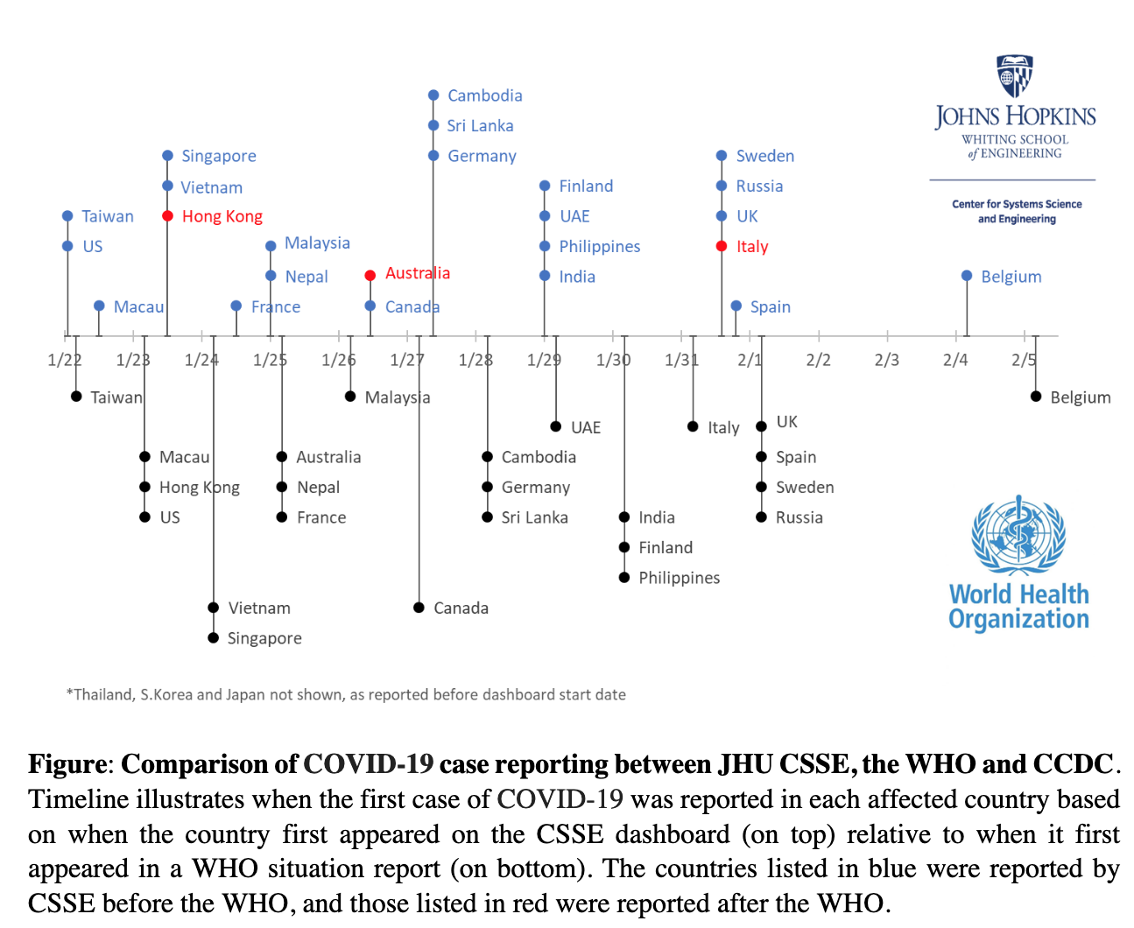

Slide 4

Welcome to the BDI Python Code Clinic on Data Scraping

Slide 5
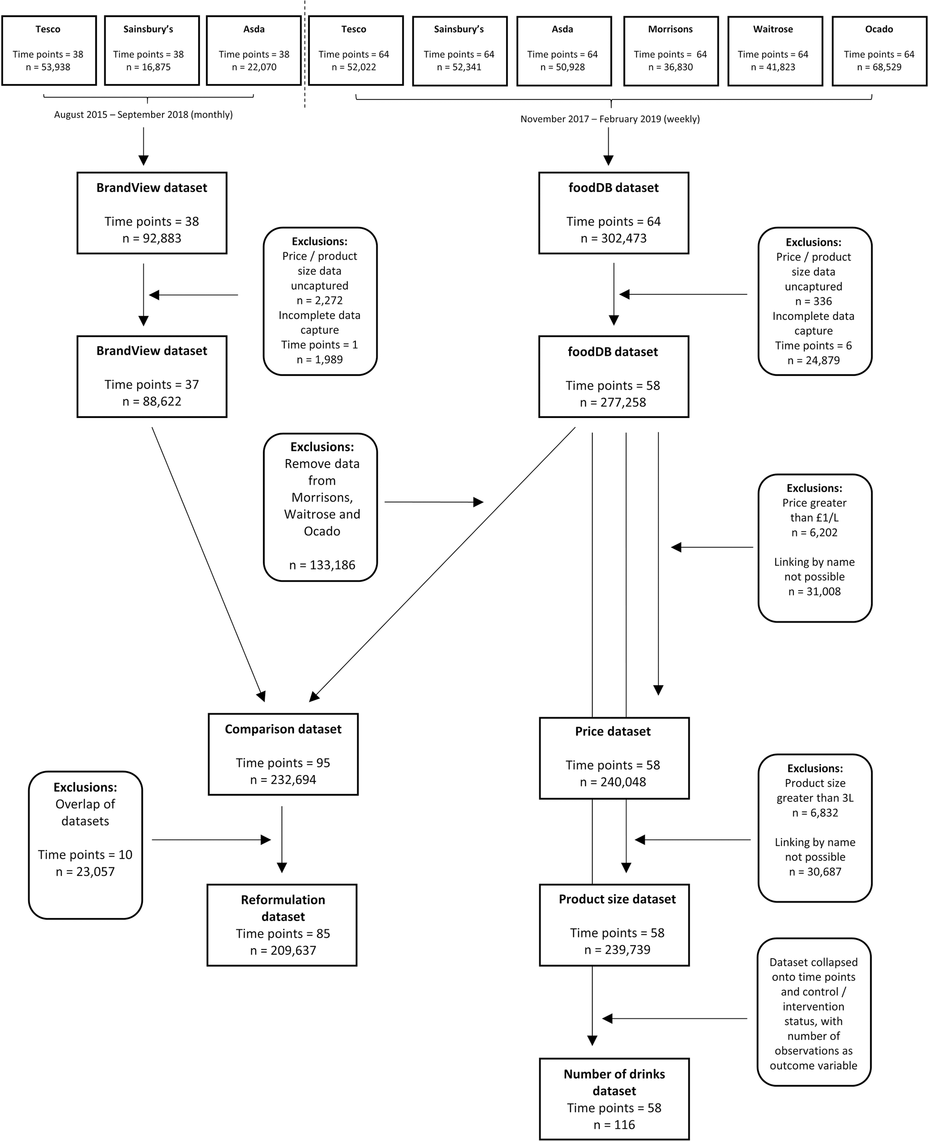

Slide 6
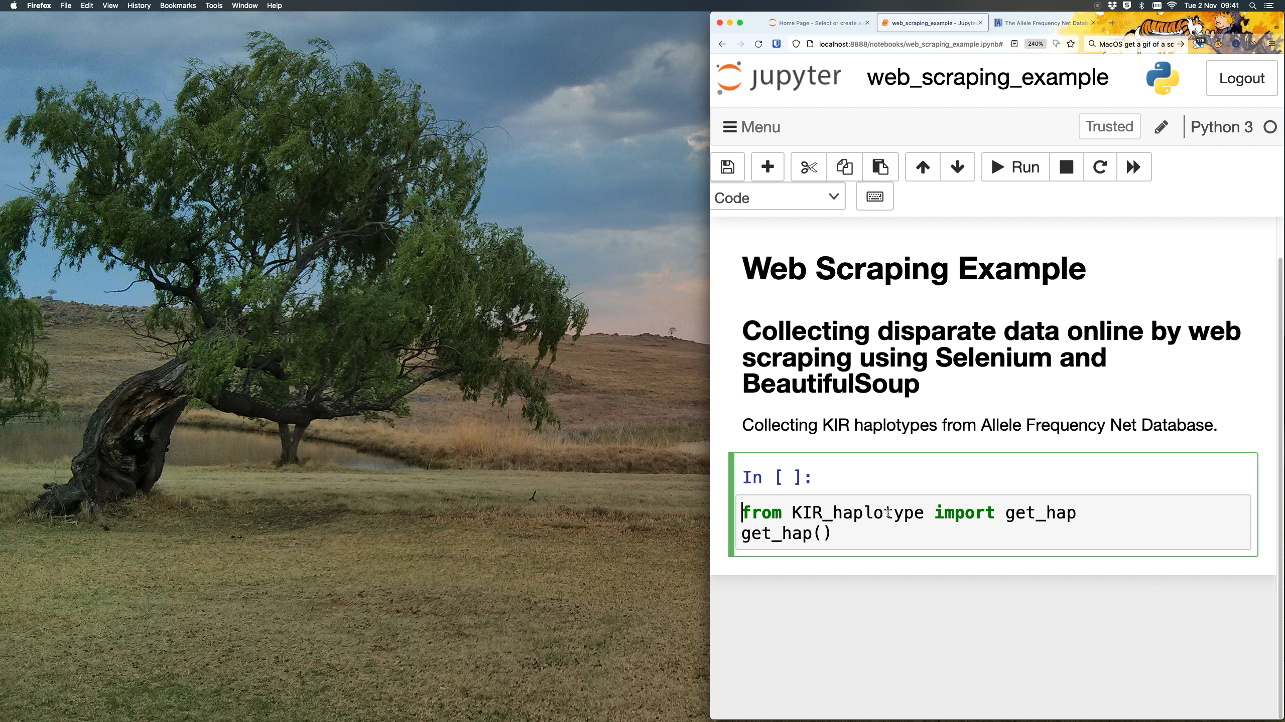

Slide 7
Welcome to the INSPIRE Session on Data Scraping
The exercise notebook can be found here:
https://github.com/jpwhalley/2023_INSPIRE-Data_Collection_in_Python

